Slide 1
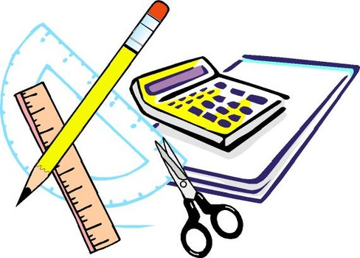
Learning Objective
I will be able graph quadratic equations
Enter quietly, please be ready with the following on your desk:
Whiteboard
Whiteboard marker
Exercise Book
Pencil, pen, ruler and red pen
Diary
Calculator (Scientific and ClassPad)
Device – charged or borrowed from Library before maths

Slide 2
Learning Objective
CFU
What will we learn today?
I will be able to graph quadratic equations
CFU
How will you know that you are successful?
Success Criteria
At the end of the lesson, I will be able to:
Sketch quadratic graphs of equations in polynomial form

Slide 3
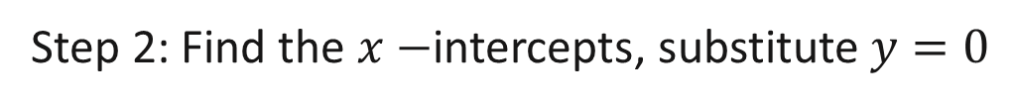
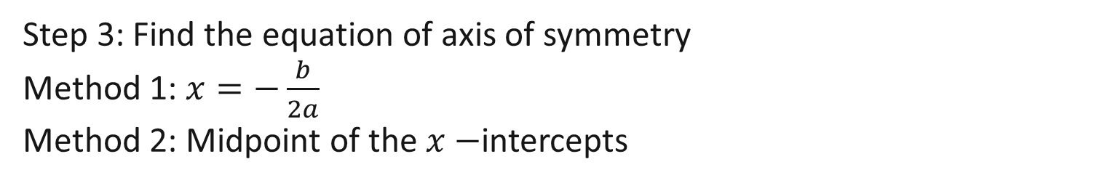
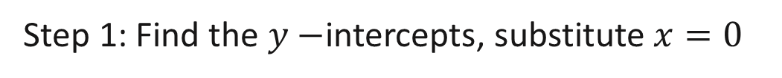
Summary of Graphing Quadratic Equations
Sketching $y=ax^{2}+bx+c$
Step 1: Find the $y−$intercepts, substitute $x=0$
Step 2: Find the $x−$intercepts, substitute $y=0$
Step 3: Find the equation of axis of symmetry
Method 1: $x=−\frac{b}{2a}$
Method 2: Midpoint of the $x−$intercepts
Step 4: Coordinates of Turning Point

Slide 4
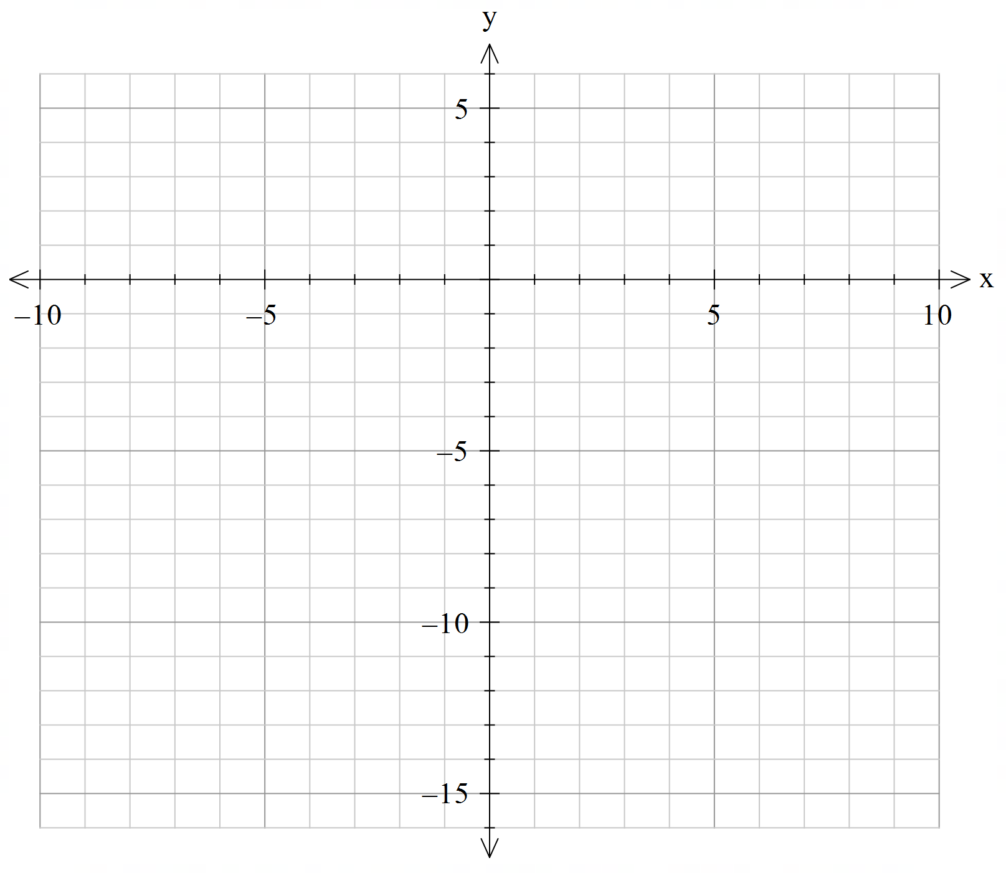
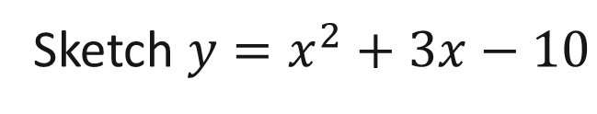
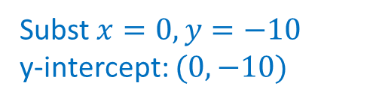
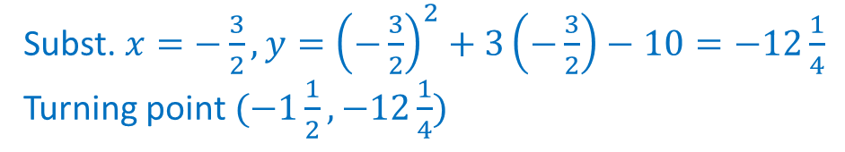
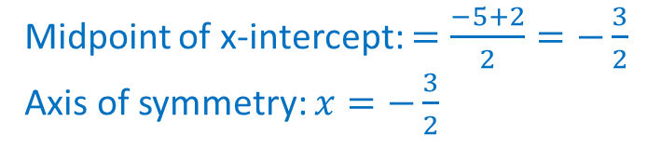
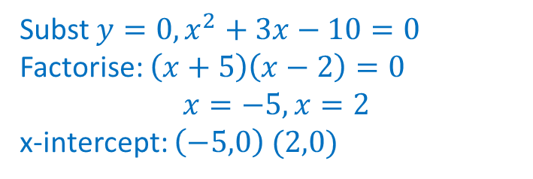
Sketching Graph
Sketch $y=x^{2}+3x−10$
Subst $x=0,y=−10$ y-intercept: $(0,−10)$
1. Determine y-intercept
2. Determine x-intercept
3. Determine axis of symmetry
4. Determine Turning Point
Subst $y=0,x^{2}+3x−10=0$ Factorise: $\left(x+5\right)\left(x−2\right)=0$ $$x=−5, x=2$$ x-intercept: $\left(−5,0\right) (2,0)$
Midpoint of x-intercept: $=\frac{−5+2}{2}=−\frac{3}{2}$ Axis of symmetry: $x=−\frac{3}{2}$
Subst. $x=−\frac{3}{2}, y={\left(−\frac{3}{2}\right)}^{2}+3\left(−\frac{3}{2}\right)−10=−12\frac{1}{4}$ Turning point $(−1\frac{1}{2},−12\frac{1}{4})$

Slide 5
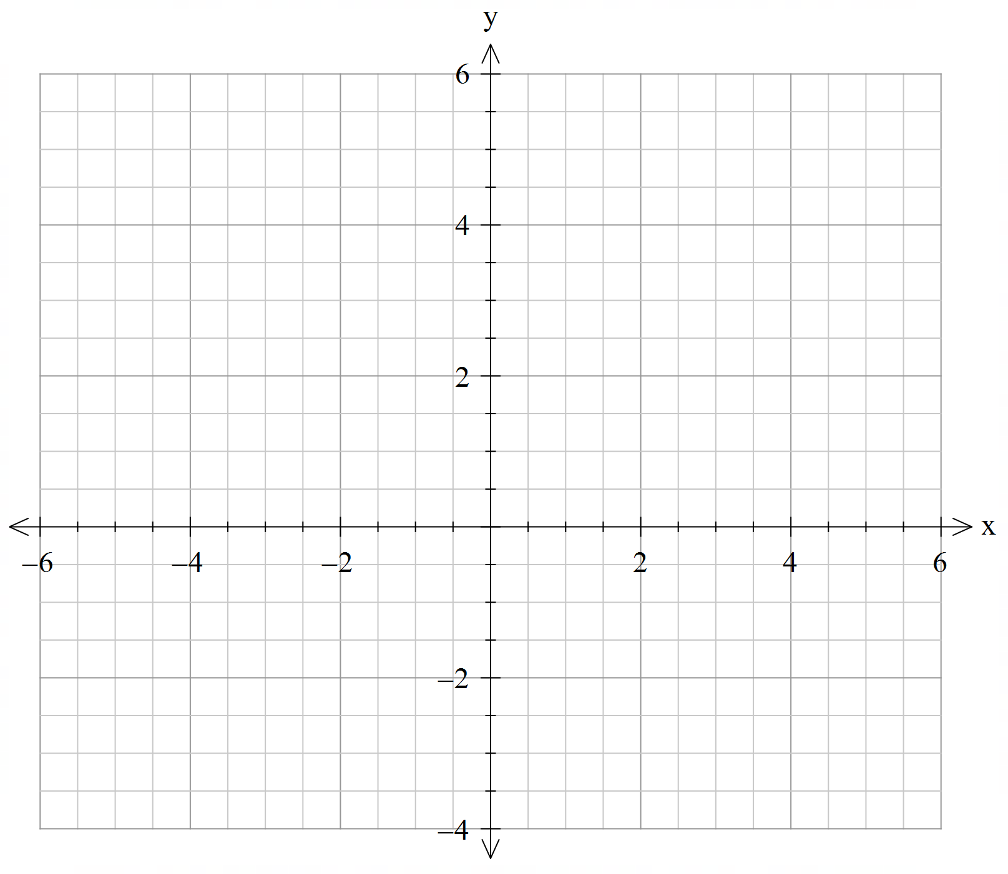
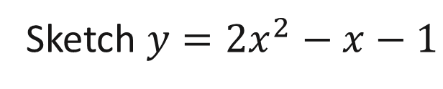
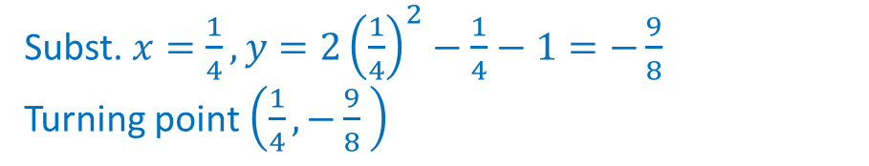
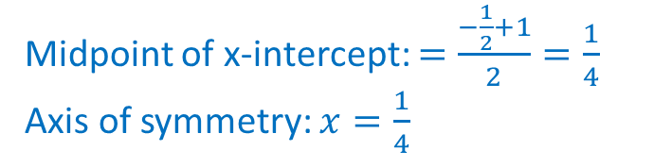
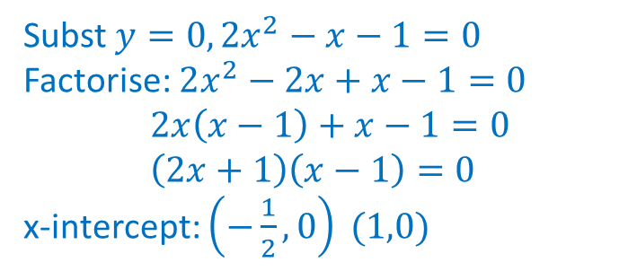
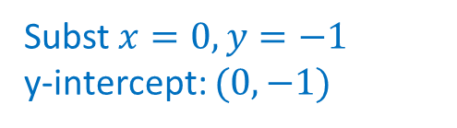
Sketching Graph
Sketch $y={2x}^{2}−x−1$
Subst $x=0,y=−1$ y-intercept: $(0,−1)$
1. Determine y-intercept
2. Determine x-intercept
3. Determine axis of symmetry
4. Determine Turning Point
Subst $y=0,{2x}^{2}−x−1=0$ Factorise: $2x^{2}−2x+x−1=0$ $$2x\left(x−1\right)+x−1=0 \\ \left(2x+1\right)\left(x−1\right)=0$$ x-intercept: $\left(−\frac{1}{2},0\right) (1,0)$
Midpoint of x-intercept: $=\frac{−\frac{1}{2}+1}{2}=\frac{1}{4}$ Axis of symmetry: $x=\frac{1}{4}$
Subst. $x=\frac{1}{4}, y=2{\left(\frac{1}{4}\right)}^{2}−\frac{1}{4}−1=−\frac{9}{8}$ Turning point $\left(\frac{1}{4},−\frac{9}{8} \right)$

Slide 6
Independent Practice
Cambridge Ex 3F

